Slide 1
Data types Data Structures and
Abstract Data Type

Slide 2
Data Type: Memory Storage + Interpretation +
Defined Operations
Defined set of operations
You can do the following between ints :
● + - * / % << >> = ==
<= etc
Size
int: 4 bytes
char: 1 bytes
Storage “capacity”
Amount of data that can be stored
You can do the following with array elements:
[ ] =
You can't do the following with two arrays
a + b

Slide 3
Data Types in C
There is no
String
Boolean

Slide 4
Knowing a data type means
Knowing precisely the size, and all defined operations
on it.

Slide 5
Semantics in a language
Semantics = meaning
What does a + b mean?
Addition of a and b? --> Why?
The meaning is “defined”, it was taught to you in school
Programming languages define the meaning of every “syntax”, you should know all semantics (meanings)
In a language meaning of a syntax may be
Defined by the “language” (universal meaning)
e.g. i = 10 ; means store 10 in i
Defined by the “implementation” (i.e. the compiler)
e.g. sizeof(int) in C
Undefined
Not defined at all, anything is possible. Don't write this code.
e.g i = i++ + i--;

Slide 6
Sizes of Data Types in C
Language does not define it
Leaves it to the compilers to determine
Ancient compilers like Turbo C have fixed sizeof(int) to be 2 bytes
Modern compilers decide the sizes of data types depending on the processors
Typically on a 32 bit processor,
sizeof(int) = 4
sizeof(short) = 2
sizeof(long) = 8

Slide 7
Sizes of Data Types in C
Rules
char: 1 byte
sizeof(long) >= sizeof(int) >= sizeof(short)
short is at least 2 bytes
long is at least 4 bytes sizeof(double) >= sizeof(float)
Find out the sizes of various data types on your computer
How?
Use sizeof(int) type operators and print sizes
Do it on at least two different processors
Use GCC and any other compiler and try again!

Slide 8
Implications of data type sizes
C is not portable
sizeof(int) is 4 bytes on some platforms and 8 on some
Programs written assuming a certain size won't work the same way!
How to solve this problem?
There are well known engineering solutions
Find one !

Slide 9
int x, y, z;
z = x + y
We know what operator ‘+’ does. We don’t know how it is does!
This is called ‘ABSTRACTION’
so int is ABSTRACT INT, all datatypes are abstract.

Slide 10
Even library functions are abstract!!
printf(..)
WE know WHAT is does but we don’t know HOW it does

Slide 11
The compilation process In more detail

Slide 12
The Compilation Process
cc
try. c
try
> cc try.c -o try
The Compiler 'cc' reads the file “Try.c”, checks for syntax errors, checks for missing declarations, grammatical errors and on finding no errors, converts the “C code into “machine code”. The machine code is stored in the file “try” (as the command said -o try)

Slide 13
Compilation Process
Exec- utable m/c Code
preprocessor
compiler
linking
m/c Code try.o
C
Code
try.c
Handles all # directives in the input C code
Checks syntax errors, grammatical errors, missing declarations,e tc. And converts the input code to machine code
Combines machine code of input file(S) and library files
try
gcc

Slide 14
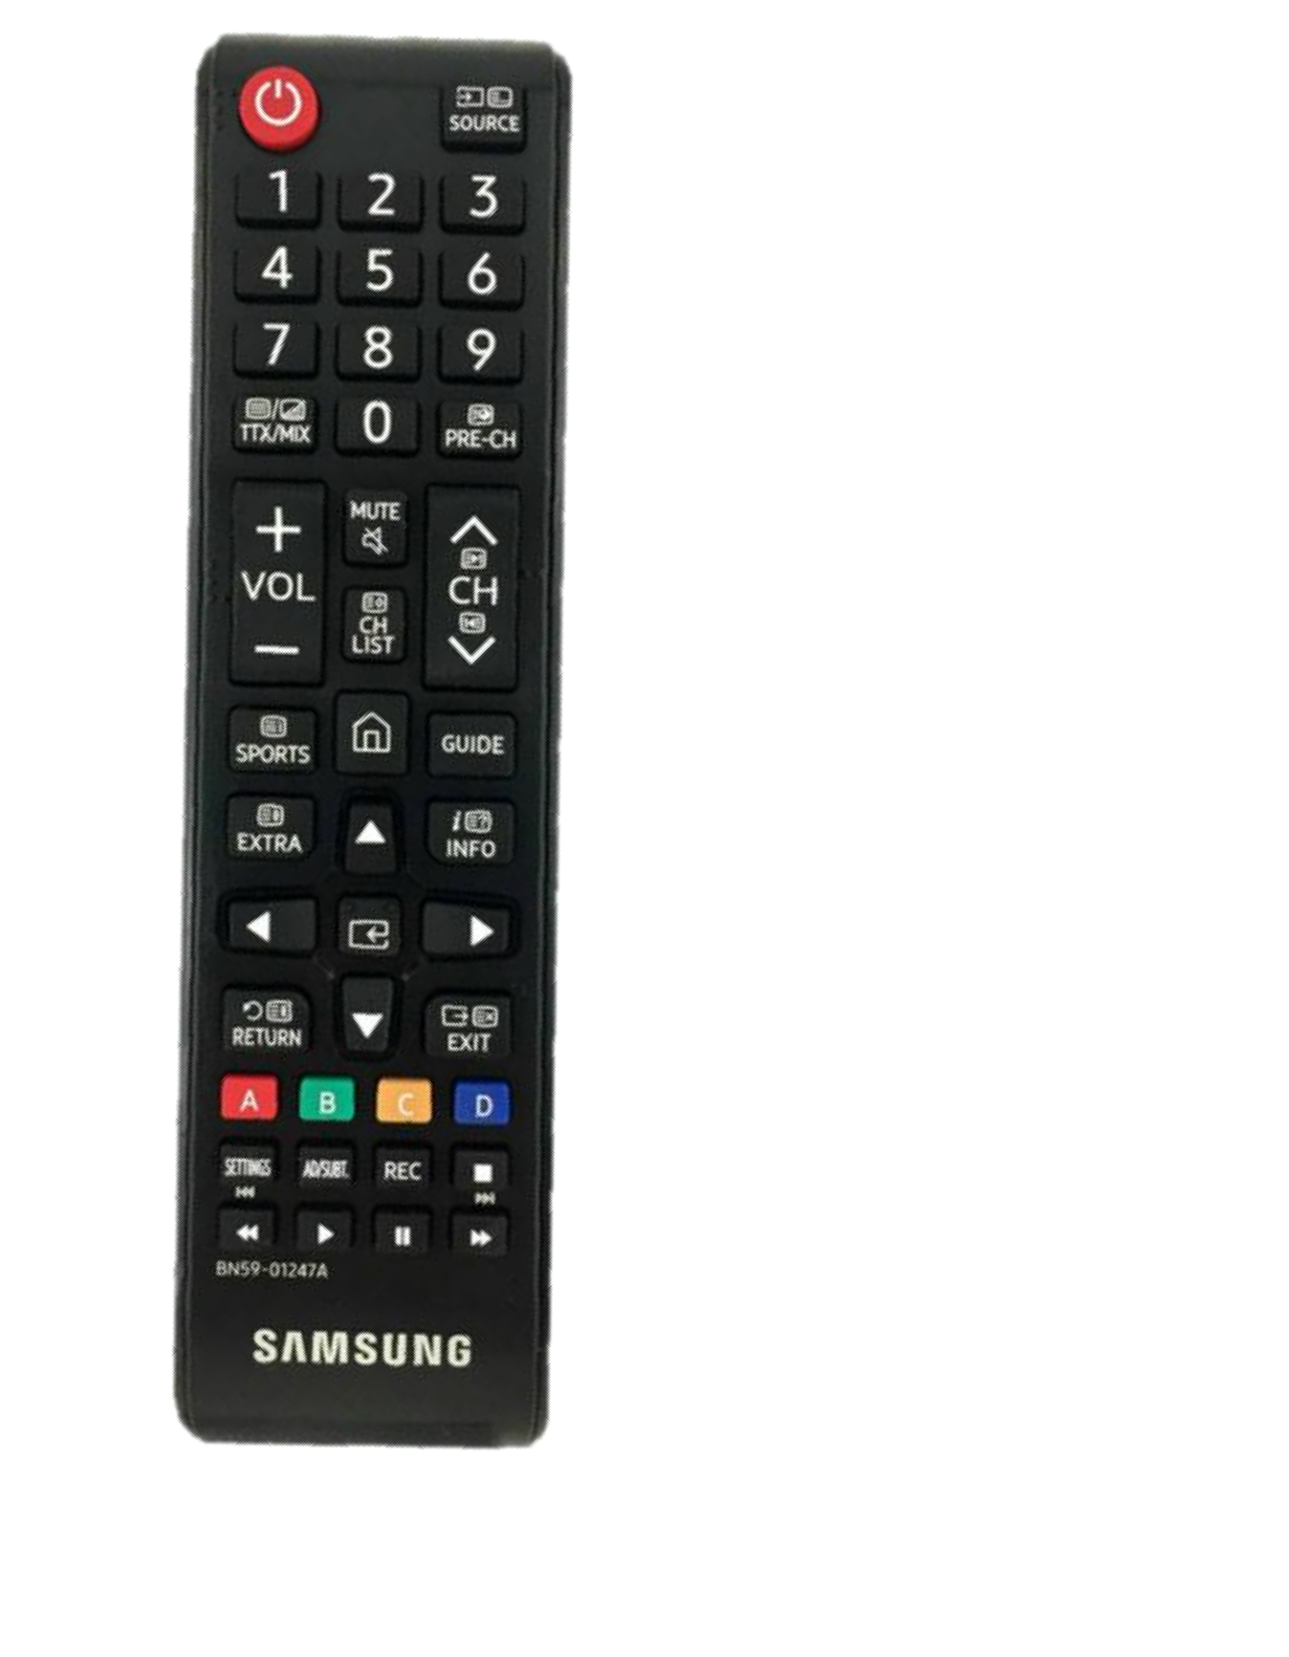

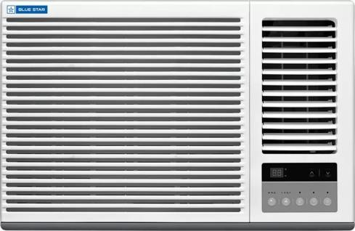
function implementations
.c file
switch ON switch OFF channel ++ channel – vol ++
vol – record jump to channel etc
.o file(1)
Compile
Interface
.h file
.exe file(3)
LINK
Some Application program
.c file
Compile
.o file(2)

Slide 15
function implementations
.c file
PUSH POP ISEMPTY ISFULL PEEK
integer
STACK
.o file(1)
Compile
Interface
.h file
.exe file(3)
LINK
Infix to Postfix conversion.
Some Application program
.c file
Maze problem
Compile
.o file(2)
Parenthesis Checking
String reversal

Slide 16
Using gcc to understand the process
Run only the preprocessor
cc -E test.c
Shows the output on the screen
Run only till compilation (no linking)
cc -c test.c
Generates the “test.o” file
Combine multiple .o files (only linking part)
cc test.o main.o try.o -o something

Slide 17
What is a data structure?
Data structures are collections of data organized in a specific way in the memory
having defined set of operations and behaviors .
Different types of data structures are:- Array
Linked List Stack
Queue
Trees Graph

Slide 18
Data structures
List- Is a sequential collection of elements of same type.
Having insert/delete/traverse/search etc.
Stack- Works in first in last out order. The element inserted first in stack is removed last.
Queue- First in First out order. The element inserted first is removed first.
Trees- Stores data in a non linear fashion with one root node and sub nodes.

Slide 19
Basic Operations
The data in the data structures are processed by certain operations. The particular data structure chosen largely depends on the frequency of the operation that needs to be performed on the data structure.

Slide 20
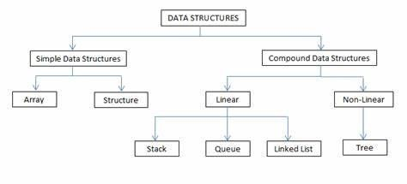

Slide 21
List Data structure eg
Arrays
Linked List

Slide 22
Data Structure : Array
<index, value> pairs
sequential mapping of array elements
Set of elements of same type
Consecutive memory allocation
Static/fixed size
Search
Sort
Insert
Traverse
Delete
Easy to implement
Expensive to perform operations like insert(beginning/middle), delete etc

Slide 23
Practice Questions on Array
Find max/min avg of array elements
Declare array of structure student: having MIS and Name.
Populate an integer array from a file
Search for an element
Sort an array using: Bubble sort/Selection Sort/ Insertion Sort/ Merge Sort/Quick Sort and analyze these sorting algorithms
Search an element in a sorted array.

Slide 24
Linked list
Linked list is sequential collection of elements (generally of same type)
Most general collection Dynamic memory allocation Traverse
Insert/Delete elements at run time
and many more…

Slide 25
types of linked list
Singly linked list Doubly linked list Circular list etc

Slide 26
List in Python
L = [1 , 2, 3, 4]
L.append(5) //[1,2,3,4,5]
L.insert(2, 6) // insert(index, value [1,2,6,3,4]
L.remove(3) // [1,2,6,4]
L.pop() // [1,2,6]
del L1 // deletes entire list

Slide 27
ADT List
List l1, l2; //allow user to declare variables of List type add(l1 ,1); // functions of List ADT
l3 = l1 + l2 print(l1)
sort(l1)

Slide 28
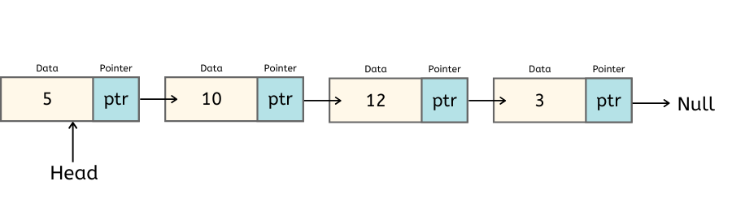
Singly Linked List

Slide 29
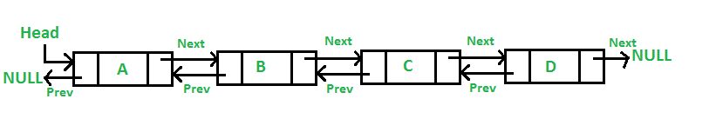
Doubly Linked List

Slide 30
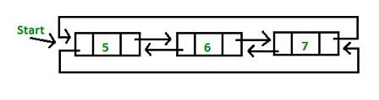
Circular Linked List

Slide 31
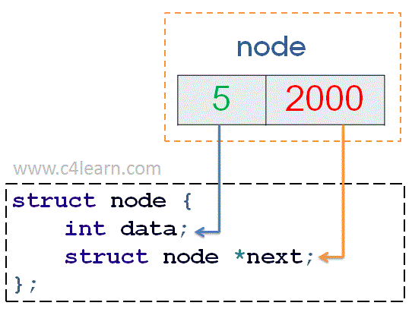
Implementation of Singly Linked List
typedef struct node { int data;
struct node *next;
}node;

